Slide 1
Potential causal connections
?
Control components
?
Target component

Slide 2
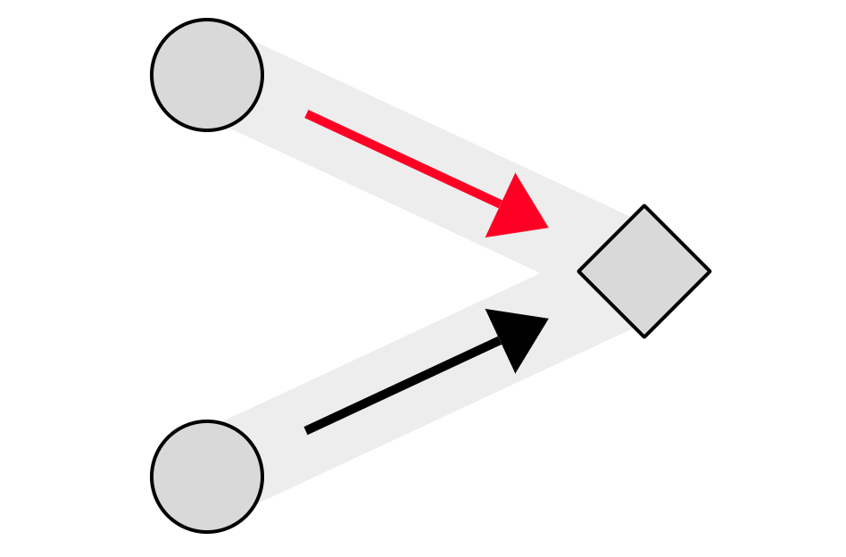

Click once:
Generate connection
Click twice:
Preventative connection
Click three times/No click:
Non-causal connection

Slide 3
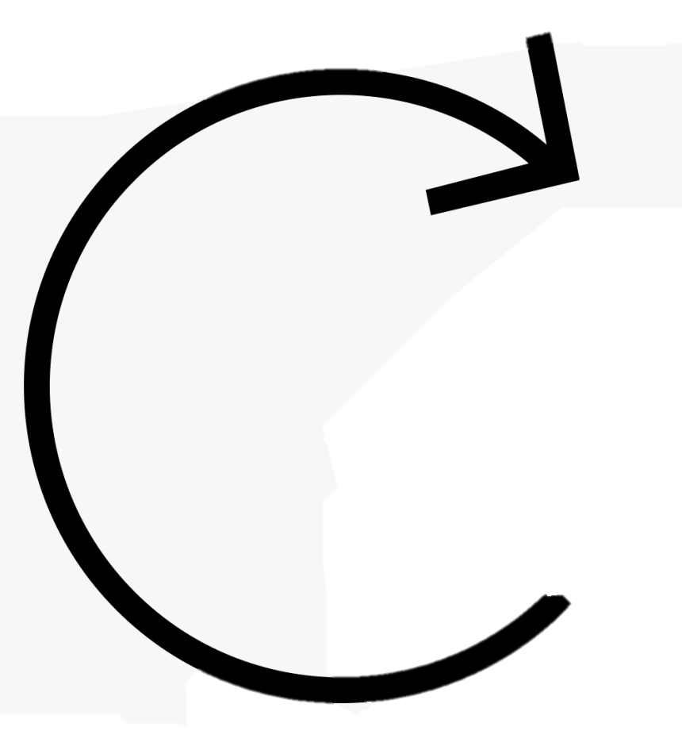
5 seconds

Slide 4
random

Slide 5
1.5s

Slide 6
3s

Slide 7
Cannot affect the activation of the target component

Slide 8

time
around 1.5 seconds later

Slide 9
X
X
time
There will be no target component’s activation within around 3 seconds

Slide 10
Unconnected control components have no impact on the target component

